Slide 1
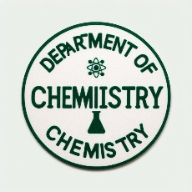

FEDERAL UNIVERSITY OF LAFIA DEPARTMENT OF CHEMISTRY
Course code: CHM102
Course Title: General Chemistry II
Course Unit: (2 Units)
Module 2: Electronic theories in organic chemistry, Isolation and purification of organic compounds. Determination of structures of organic compounds including qualitative and quantitative analysis in organic chemistry.

Slide 2
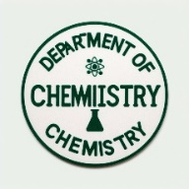
MODULE OBJECTIVES
Electronic theories in organic chemistry
Isolation and purification of organic compounds
Determination of structures of organic compounds including qualitative and quantitative analysis in organic chemistry

Slide 3
Introduction to Organic Chemistry
- Organic chemistry is the branch of chemistry that studies compounds containing carbon.
- Carbon is unique in its ability to form diverse and complex structures, making organic chemistry crucial for understanding life processes.
- Applications include pharmaceuticals, polymers, fuels, and more.

Slide 4
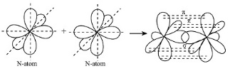
Electronic theories in organic chemistry
Valence Bond Theory (VB)
Focuses on the idea that covalent bonds form when atomic orbitals overlap.
Emphasizes the role of electron pairs and hybridization.
Explains bonding and structure of organic molecules.

Slide 5
Molecular Orbital Theory (MO)
-Considers electrons in molecules as occupying molecular orbitals, which are combinations of atomic orbitals.
-Explains the delocalization of electrons in conjugated systems and aromatic compounds.
-Provides insight into the electronic structure of molecules like benzene, where π-electrons are delocalized over the ring.

Slide 6
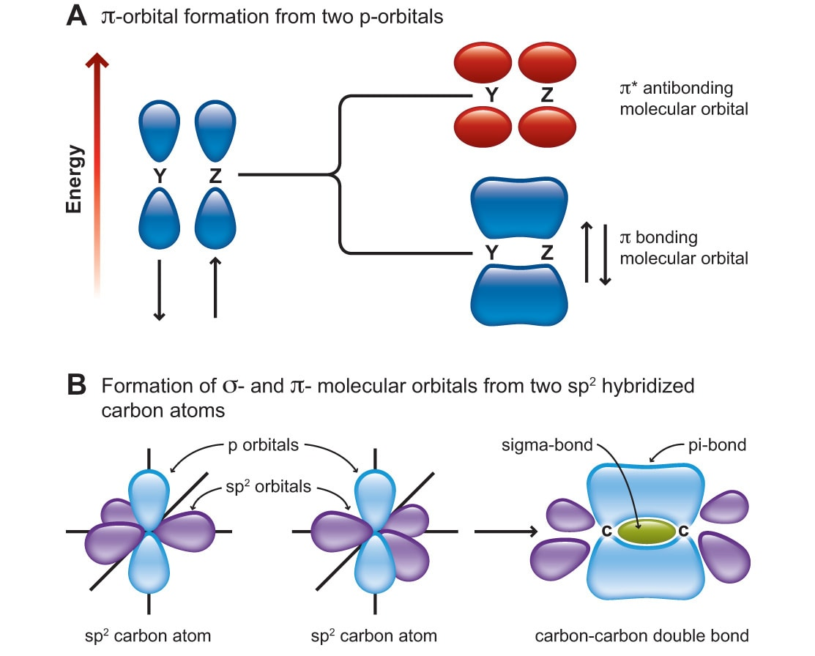

Slide 7
Frontier Molecular Orbital Theory (FMO)
-Focuses on the interactions between the highest occupied molecular orbital (HOMO) of one molecule and the lowest unoccupied molecular orbital (LUMO) of another.
-Useful in explaining the reactivity in chemical reactions, such as nucleophilic and electrophilic additions.

Slide 8
Electron Density and Electrostatic Potential Maps
Visualize electron density distribution within a molecule.
Electrostatic potential maps show regions of positive and negative charge, aiding in understanding reactivity patterns.
Resonance Theory
-Describes the delocalization of electrons within a molecule by using multiple contributing structures (resonance forms).
-Helps explain stability and reactivity in compounds like benzene and carboxylate ions.

Slide 9
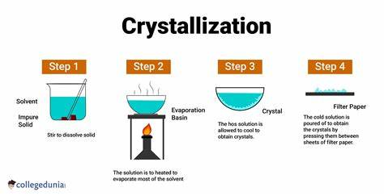
Crystallization
This method involves cooling a solution of the compound to form crystals. The desired compound crystallizes out, while impurities remain in the solution. Crystallization is widely used for purifying solids.

Slide 10
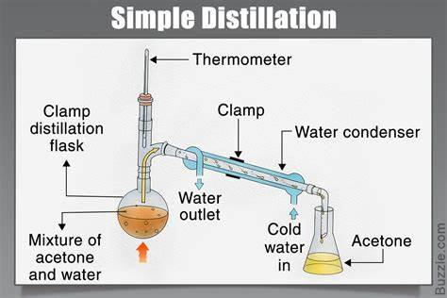
Distillation
Distillation is effective for separating volatile liquids based on their boiling points. Simple distillation is suitable for compounds with significantly different boiling points, while fractional distillation is used when the boiling points are closer.

Slide 11
Extraction
Solid-liquid extraction: If the compound is very soluble, stirring or shaking a solid-liquid mixture followed by gravity filtration can suffice. For less soluble compounds, a Soxhlet extractor is used.
Liquid-liquid extraction: This method separates a component from one liquid phase into another. Typically, one phase is aqueous, and the other is an immiscible organic liquid. Shaking the two phases together in a separatory funnel allows separation.

Slide 12
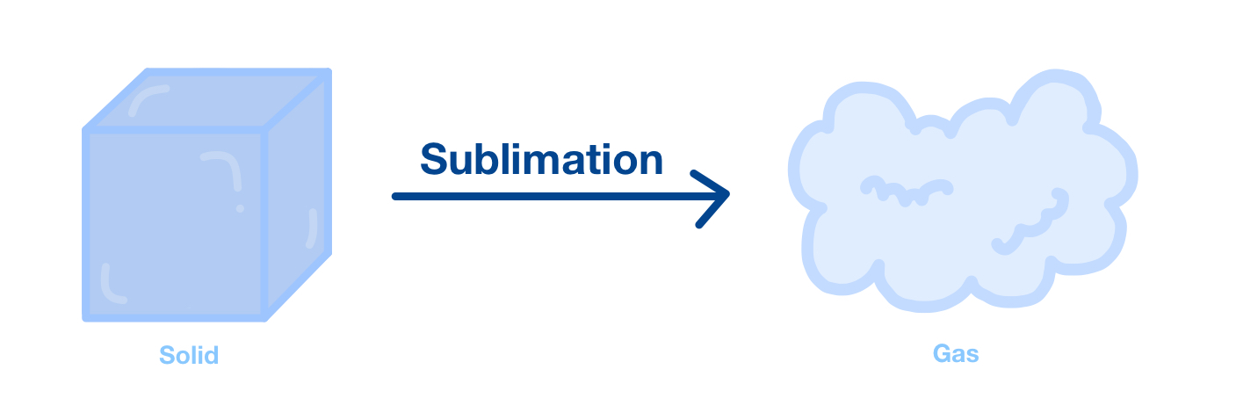
Sublimation
Some solids can directly change from the solid to vapor state (sublimation) under specific conditions. This process helps purify volatile organic compounds.

Slide 13
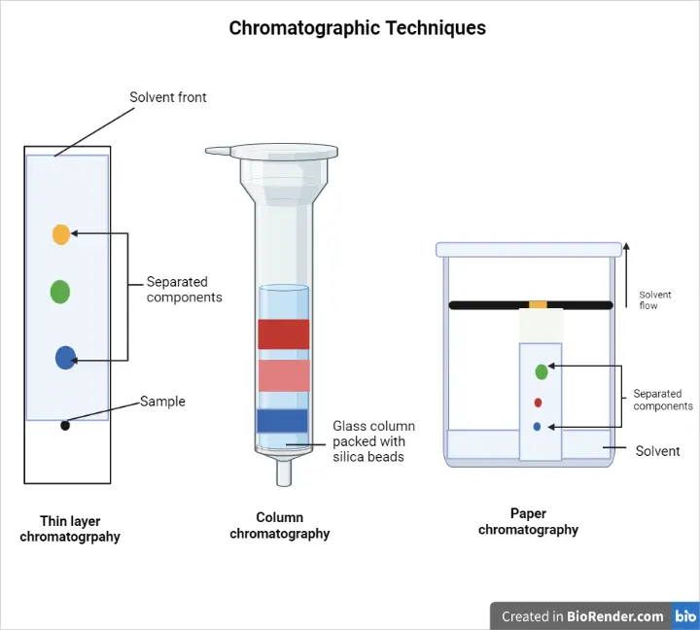
Chromatography
Techniques like column chromatography, thin-layer chromatography (TLC), and gas chromatography (GC) separate compounds based on their affinity for a stationary phase. These methods are valuable for complex mixtures.

Slide 14
Qualitative Organic Analysis
In qualitative analysis, we identify which elements are present in an organic compound. It helps us understand the composition of the compound.
For instance, we can determine whether an unknown substance contains carbon, hydrogen, oxygen, nitrogen, or other elements.
Quantitative Organic Analysis
In quantitative analysis, we calculate the percentage amount of a specific element in an organic compound.
Organic compounds are primarily composed of carbon and hydrogen, but other elements may also be present.

Slide 15
Importance of organic compound structure determination
-It helps to confirm the identity and purity of a synthesized or isolated organic compound
-It helps to understand the chemical reactions and interactions of organic compounds with other molecules
-It helps to discover new organic compounds with potential applications in medicine, agriculture, industry, and other fields
-It helps to elucidate the natural biosynthesis and metabolism of organic compounds in living organisms.

Slide 16
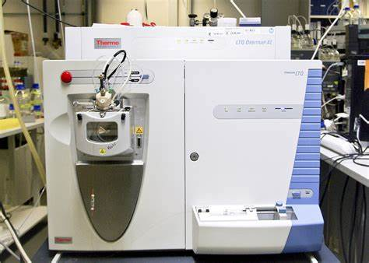
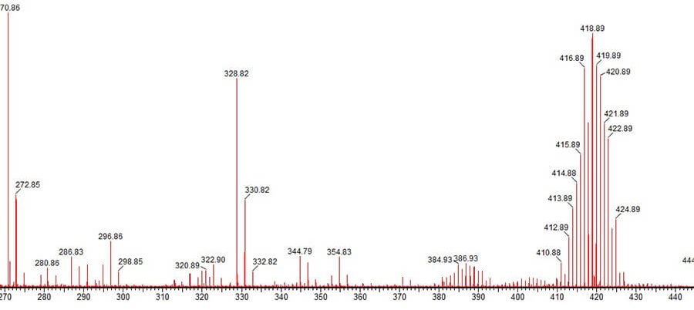
Mass spectrometry measures the mass-to-charge ratio of ionized molecules, and can provide information on the molecular formula, molecular weight, and fragmentation pattern of an organic compound.

Slide 17
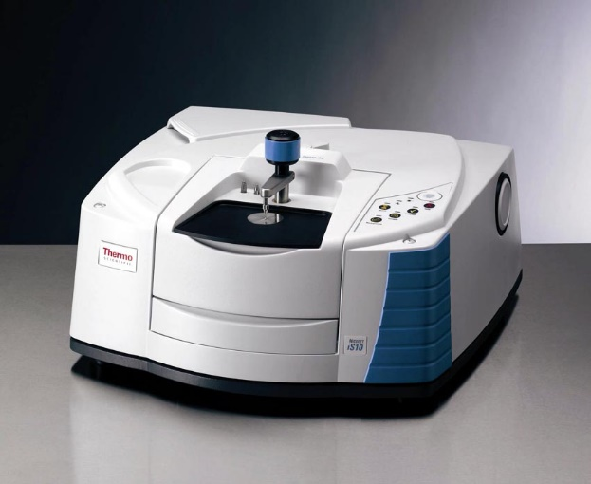
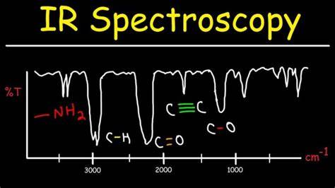
Infrared spectroscopy measures the absorption of infrared radiation by molecular vibrations, and can provide information on the functional groups and bond types present in an organic compound.

Slide 18
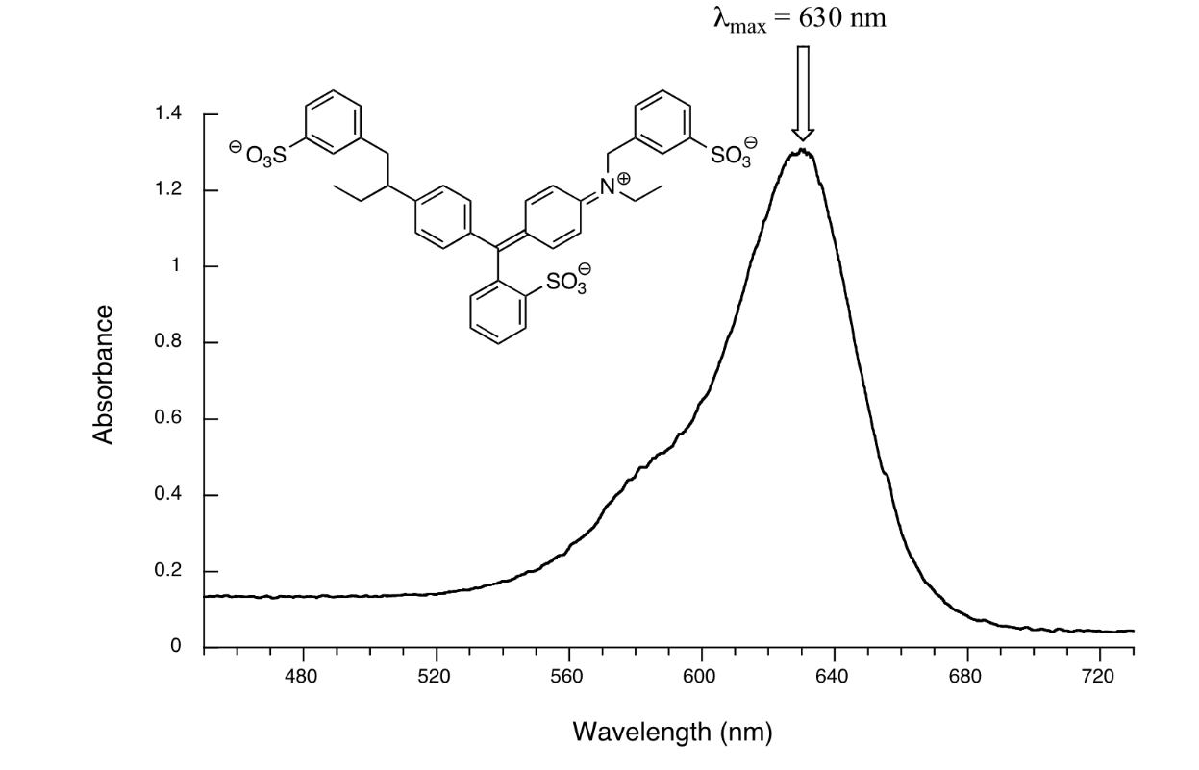
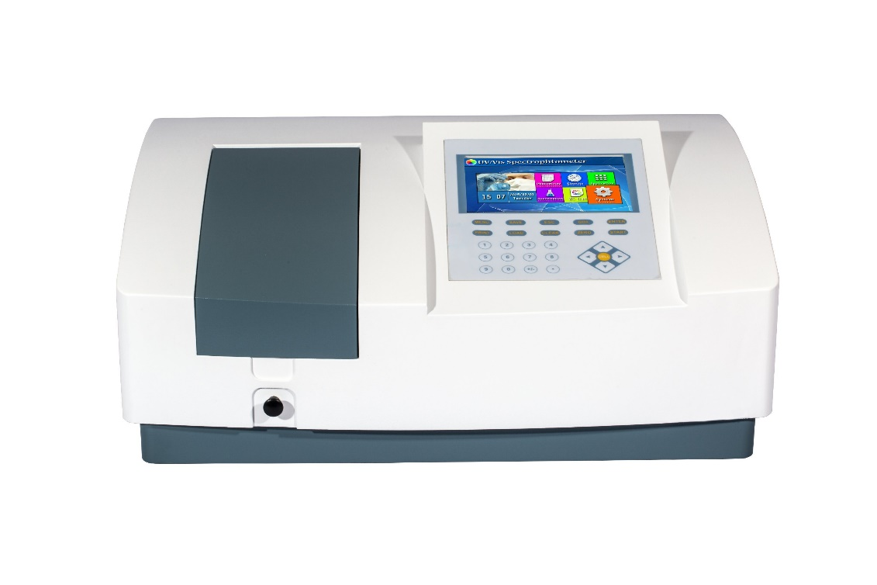
Ultraviolet/visible spectroscopy measures the absorption of ultraviolet or visible light by electrons in molecular orbitals, and can provide information on the presence and extent of conjugation and unsaturation in an organic compound.
The structure of an organic compound can be deduced by combining the information from different spectroscopic techniques, and comparing it with known data and chemical logic.

Slide 19
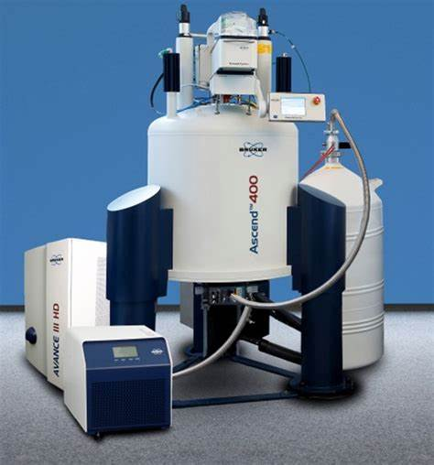
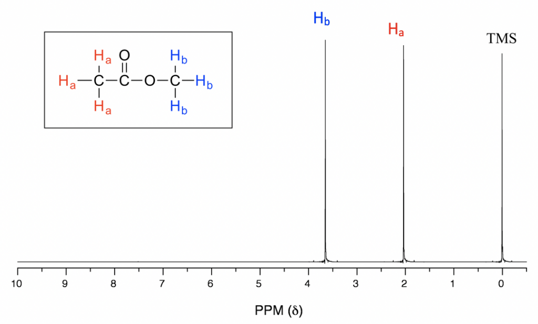
Nuclear magnetic resonance spectroscopy measures the interaction of nuclear spins with a magnetic field, and can provide information on the number, type, and environment of hydrogen and carbon atoms in an organic compound. NMR uses magnetic properties to determine the structure. It provides information about atom connectivity.

Slide 20
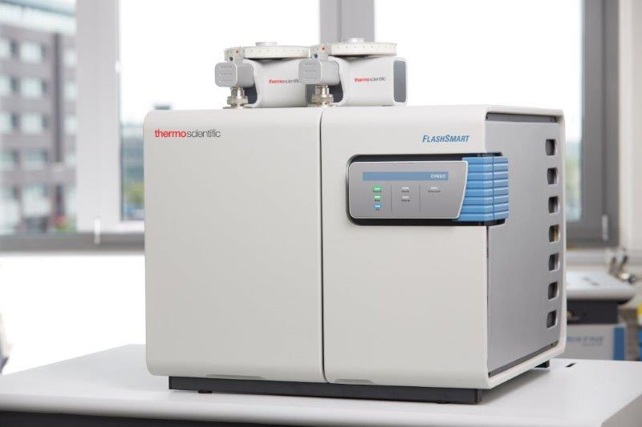
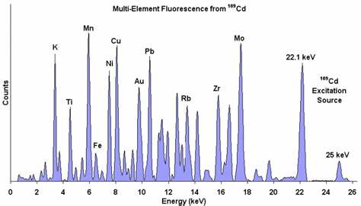
Elemental analysis of organic compounds is a process where a sample of some material (e.g., soil, waste or drinking water, bodily fluids, minerals, chemical compounds) is analyzed for its elemental and sometimes isotopic composition.

Slide 21
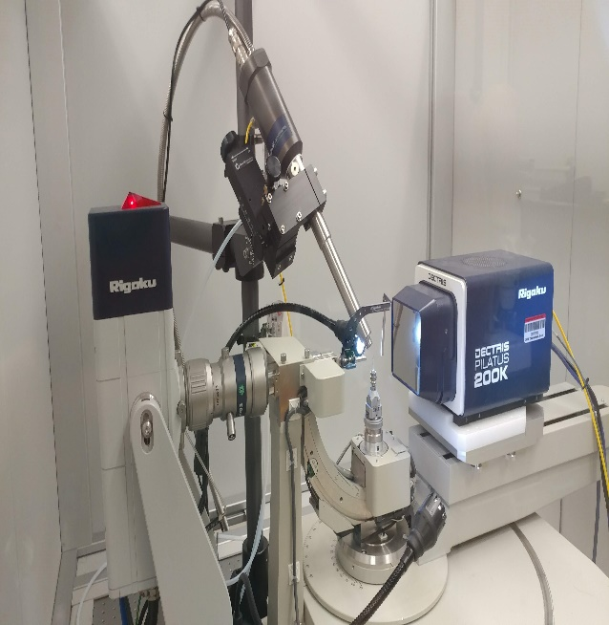
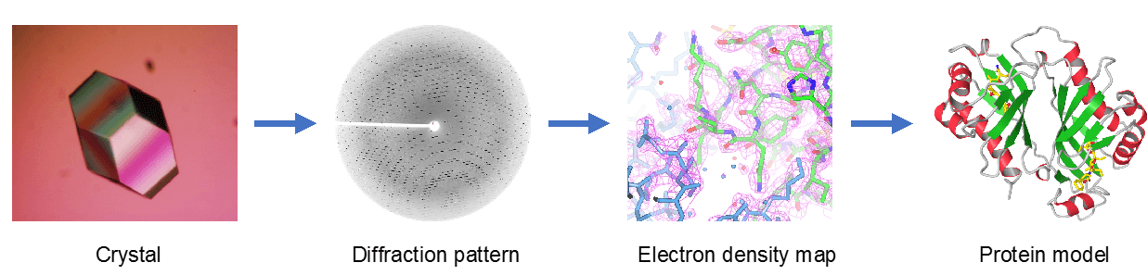
X-ray crystallography provides precise structural information.
It helps us understand the 3D arrangement of atoms in a crystal lattice.

Slide 22
Common Challenges
Impurities
Solvent effects
Complex mixtures
Understanding and addressing these issues is vital for accurate results.
Another challenge is to deal with the complexity and diversity of organic molecules, which can have different isomers, conformations, stereochemistry, and reactivity

Slide 23
Thank you

